Slide 1

NeuroFleetX
AI-Driven Urban Mobility Optimization Platform
Transforming fleet management and urban transportation through intelligent, data-driven optimization

Slide 2


The Urban Mobility Challenge
Urban transportation systems face increasing complexity due to rapid urbanization, rising vehicle density, and inefficient fleet operations. Traditional fleet management systems rely heavily on manual monitoring, static routing, and reactive maintenance strategies.
Limited Visibility
No real-time vehicle tracking or location awareness
Inefficient Routing
Static routes cause fuel and time loss
Reactive Maintenance
Unexpected breakdowns from poor planning
Data Gaps
Limited data-driven decision-making

Slide 3
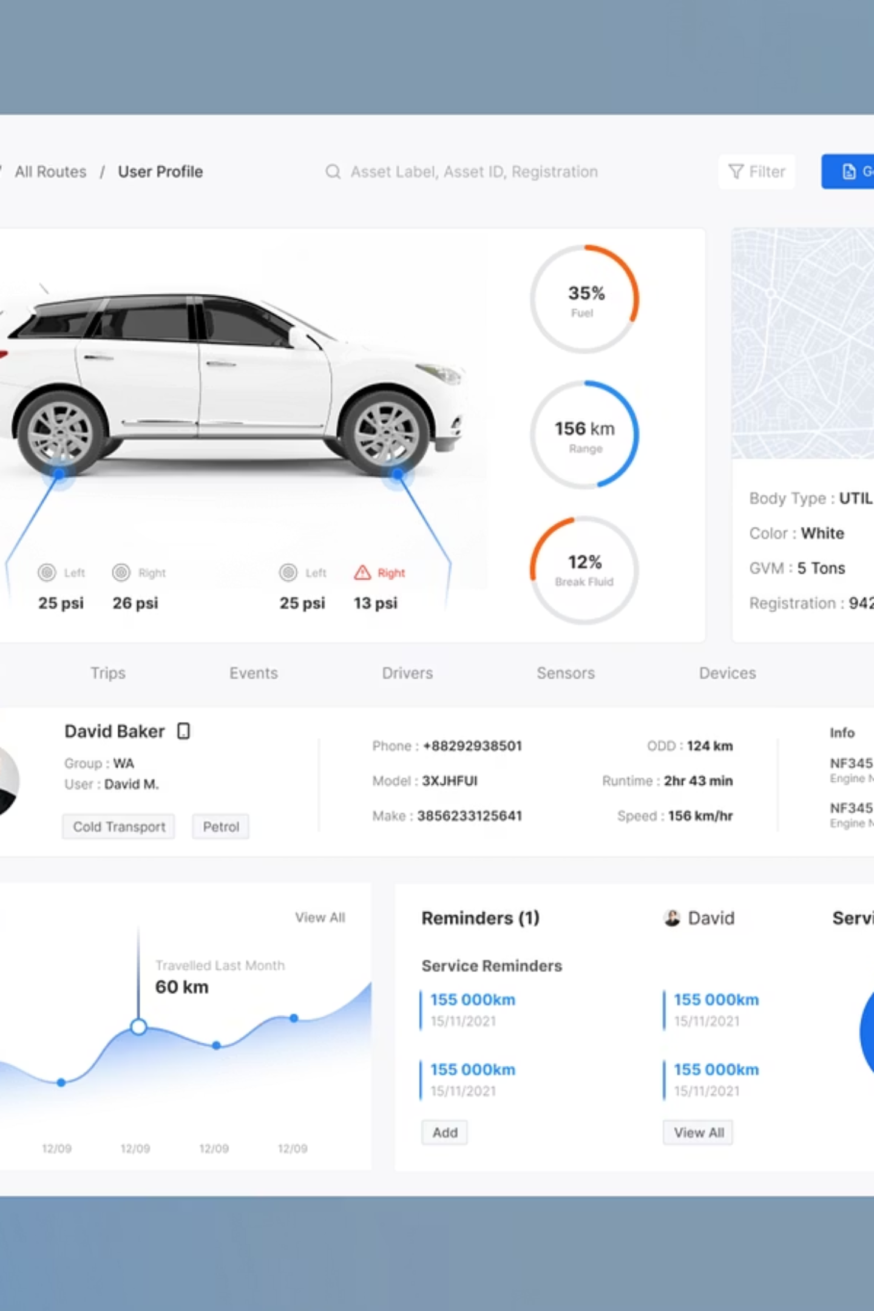
Introducing NeuroFleetX
NeuroFleetX is an intelligent, AI-powered fleet and urban mobility optimization system designed for rental services, logistics providers, ride-sharing platforms, and smart cities.
Key Benefits
Reduced operational costs
Enhanced customer experience
Lower environmental impact
Improved fleet utilization
The platform transforms traditional fleet management by providing real-time visibility, AI-driven optimization, and predictive analytics that reduce costs while improving customer satisfaction and promoting sustainable urban mobility.

Slide 4




How NeuroFleetX Works
Data Collection
AI Processing
Vehicles continuously send telemetry data via IoT sensors
AI models analyze traffic, routes, and vehicle health in real-time
Optimization
Visualization
System recommends optimal actions and routes
Decision insights displayed via intuitive dashboards
The solution integrates AI, IoT, cloud-based backend services, and map APIs to create a unified smart mobility ecosystem. It uses widely adopted technologies with modular architecture for easy scaling and incremental deployment.

Slide 5
Complete System Architecture
01
02
03
User Authentication
Data Collection
AI Processing Layer
Secure JWT-based login for Admin, Manager, Driver, or Customer roles
Vehicle telemetry data (location, speed, fuel/battery, health) collected via IoT or simulation
Traffic prediction, route optimization, and maintenance forecasting
04
05
Backend Processing
Visualization & Actions
Spring Boot APIs handle business logic and data storage
Dashboards display insights, alerts and recommendations generated

Slide 6
Development Methodology
1
2
3
Modular Architecture
AI-Assisted Decision Making
Simulation-Based Prototyping
Each feature developed as an independent module for flexibility and scalability
Combines rule-based logic with machine learning models for intelligent recommendations
Telemetry and AI logic simulated for demo and testing before deployment
4
5
RESTful API Design
Iterative Development
Backend exposes APIs for frontend and AI services integration
Continuous improvement based on performance metrics and user feedback
This methodology ensures flexibility, scalability, and real-world adaptability for diverse fleet management scenarios.

Slide 7


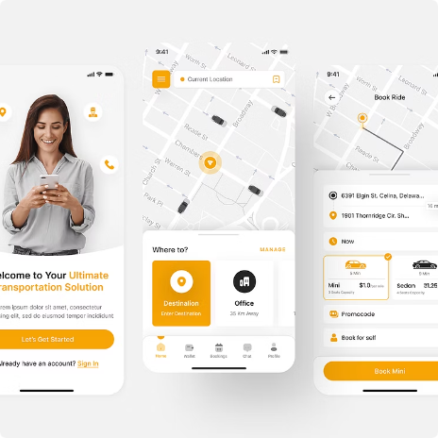
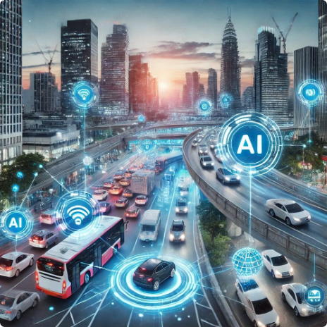
Key Use Cases
Fleet Manager
Driver
Customer
Admin / Smart City Authority
Monitor vehicle availability and health
Receive maintenance alerts
Optimize fleet allocation
Get optimized routes with traffic awareness
View assigned trips and vehicle status
Search and book vehicles
Receive AI-based recommendations
View booking history
Analyze fleet distribution and trip density
Access urban mobility insights and reports

Slide 8
Core System Modules
Authentication & Role Management
Fleet Inventory & Telemetry
Secure login, role-based access control, and personalized dashboards
Vehicle CRUD operations, real-time status monitoring, and location tracking
AI Route & Load Optimization
Predictive Maintenance
Traffic-aware routing, energy-efficient paths, and ETA prediction
Health analytics, proactive alerts, and maintenance scheduling
Customer Booking & Recommendations
Admin Analytics Dashboard
Smart search, availability calendar, and AI-powered suggestions
Heatmaps, KPIs, downloadable reports, and urban mobility insights

Slide 9
Technology Stack
Frontend
Backend
Angular 19 / React 19 with responsive, mobile-first UI design
Java Spring Boot with RESTful APIs for robust server operations
Database
AI & Analytics
MySQL for reliable data storage and management
Python Flask microservices or Java-based ML logic for route optimization and prediction models
Maps & Location
Security
Google Maps API / Leaflet.js for geospatial visualization
Spring Security + JWT Authentication for secure access
Visualization
Integrations
Chart.js / ApexCharts / Recharts for data visualization
WebSockets for real-time updates, Email (SMTP) for notifications

Slide 10

Transforming Urban Mobility
40%
25%
99%
Cost Reduction
Efficiency Gain
System Uptime
Lower operational expenses through optimization
Improved fleet utilization and route efficiency
Reliable, cloud-based infrastructure
NeuroFleetX is ready for deployment across rental services, logistics providers, ride-sharing platforms, and smart city initiatives. The modular architecture allows incremental implementation, starting with basic tracking and expanding to full AI-powered optimization.
Join the future of urban mobility. Experience intelligent fleet management that reduces costs, improves customer satisfaction, and promotes sustainable transportation.

